Slide 1
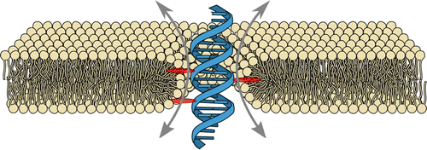
Computational Design of Biomimetic Transmembrane DNA Nanostructures
Qualifying Proposal
Ezry Santiago-McRae
DOI: (10.1021/acs.nanolett.6b02039)

Slide 2
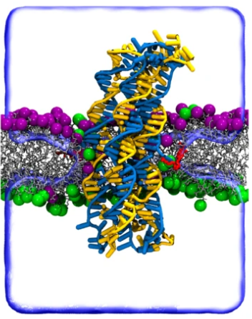
What is a “Biomimetic Transmembrane Nanostructure”?
Biomimetic - Inspired by life
Transmembrane - Crossing a plasma membrane
Nanostructure - Less than 1 micron in size
Example of a DNA transmembrane nanostructure
Figure from: Ohmann, A., Li, CY., Maffeo, C. et al. A synthetic enzyme built from DNA flips 107 lipids per second in biological membranes. Nat Commun 9, 2426 (2018). https://doi.org/10.1038/s41467-018-04821-5

Slide 3
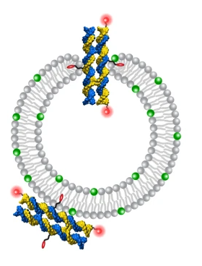
Ultimate Goal:
Design
Validation
Implementation
synthetic vesicles functionalized with amphipathic DNA nanostructures.
Figure adapted from: Ohmann, A., Li, CY., Maffeo, C. et al. A synthetic enzyme built from DNA flips 107 lipids per second in biological membranes. Nat Commun 9, 2426 (2018). https://doi.org/10.1038/s41467-018-04821-5

Slide 4
Components - Membranes and DNA

Slide 5
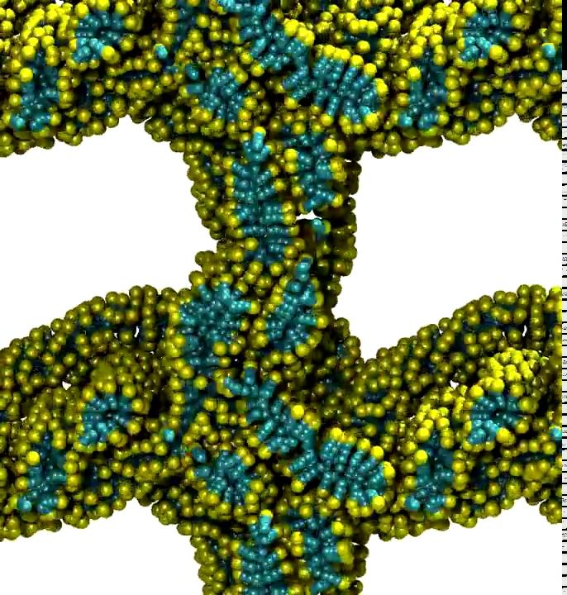
Molecules make Membranes
Key Membrane Features:
Self-assembled
Amphipathic
Bilayers
Natural: (phospho)lipids
Artificial: polymers and more exotic organics
Sodium Dodecyl Sulfate membranes. Coarse-grained simulation (Martini, Gromacs).
Santiago and Brannigan, unpublished.

Slide 6
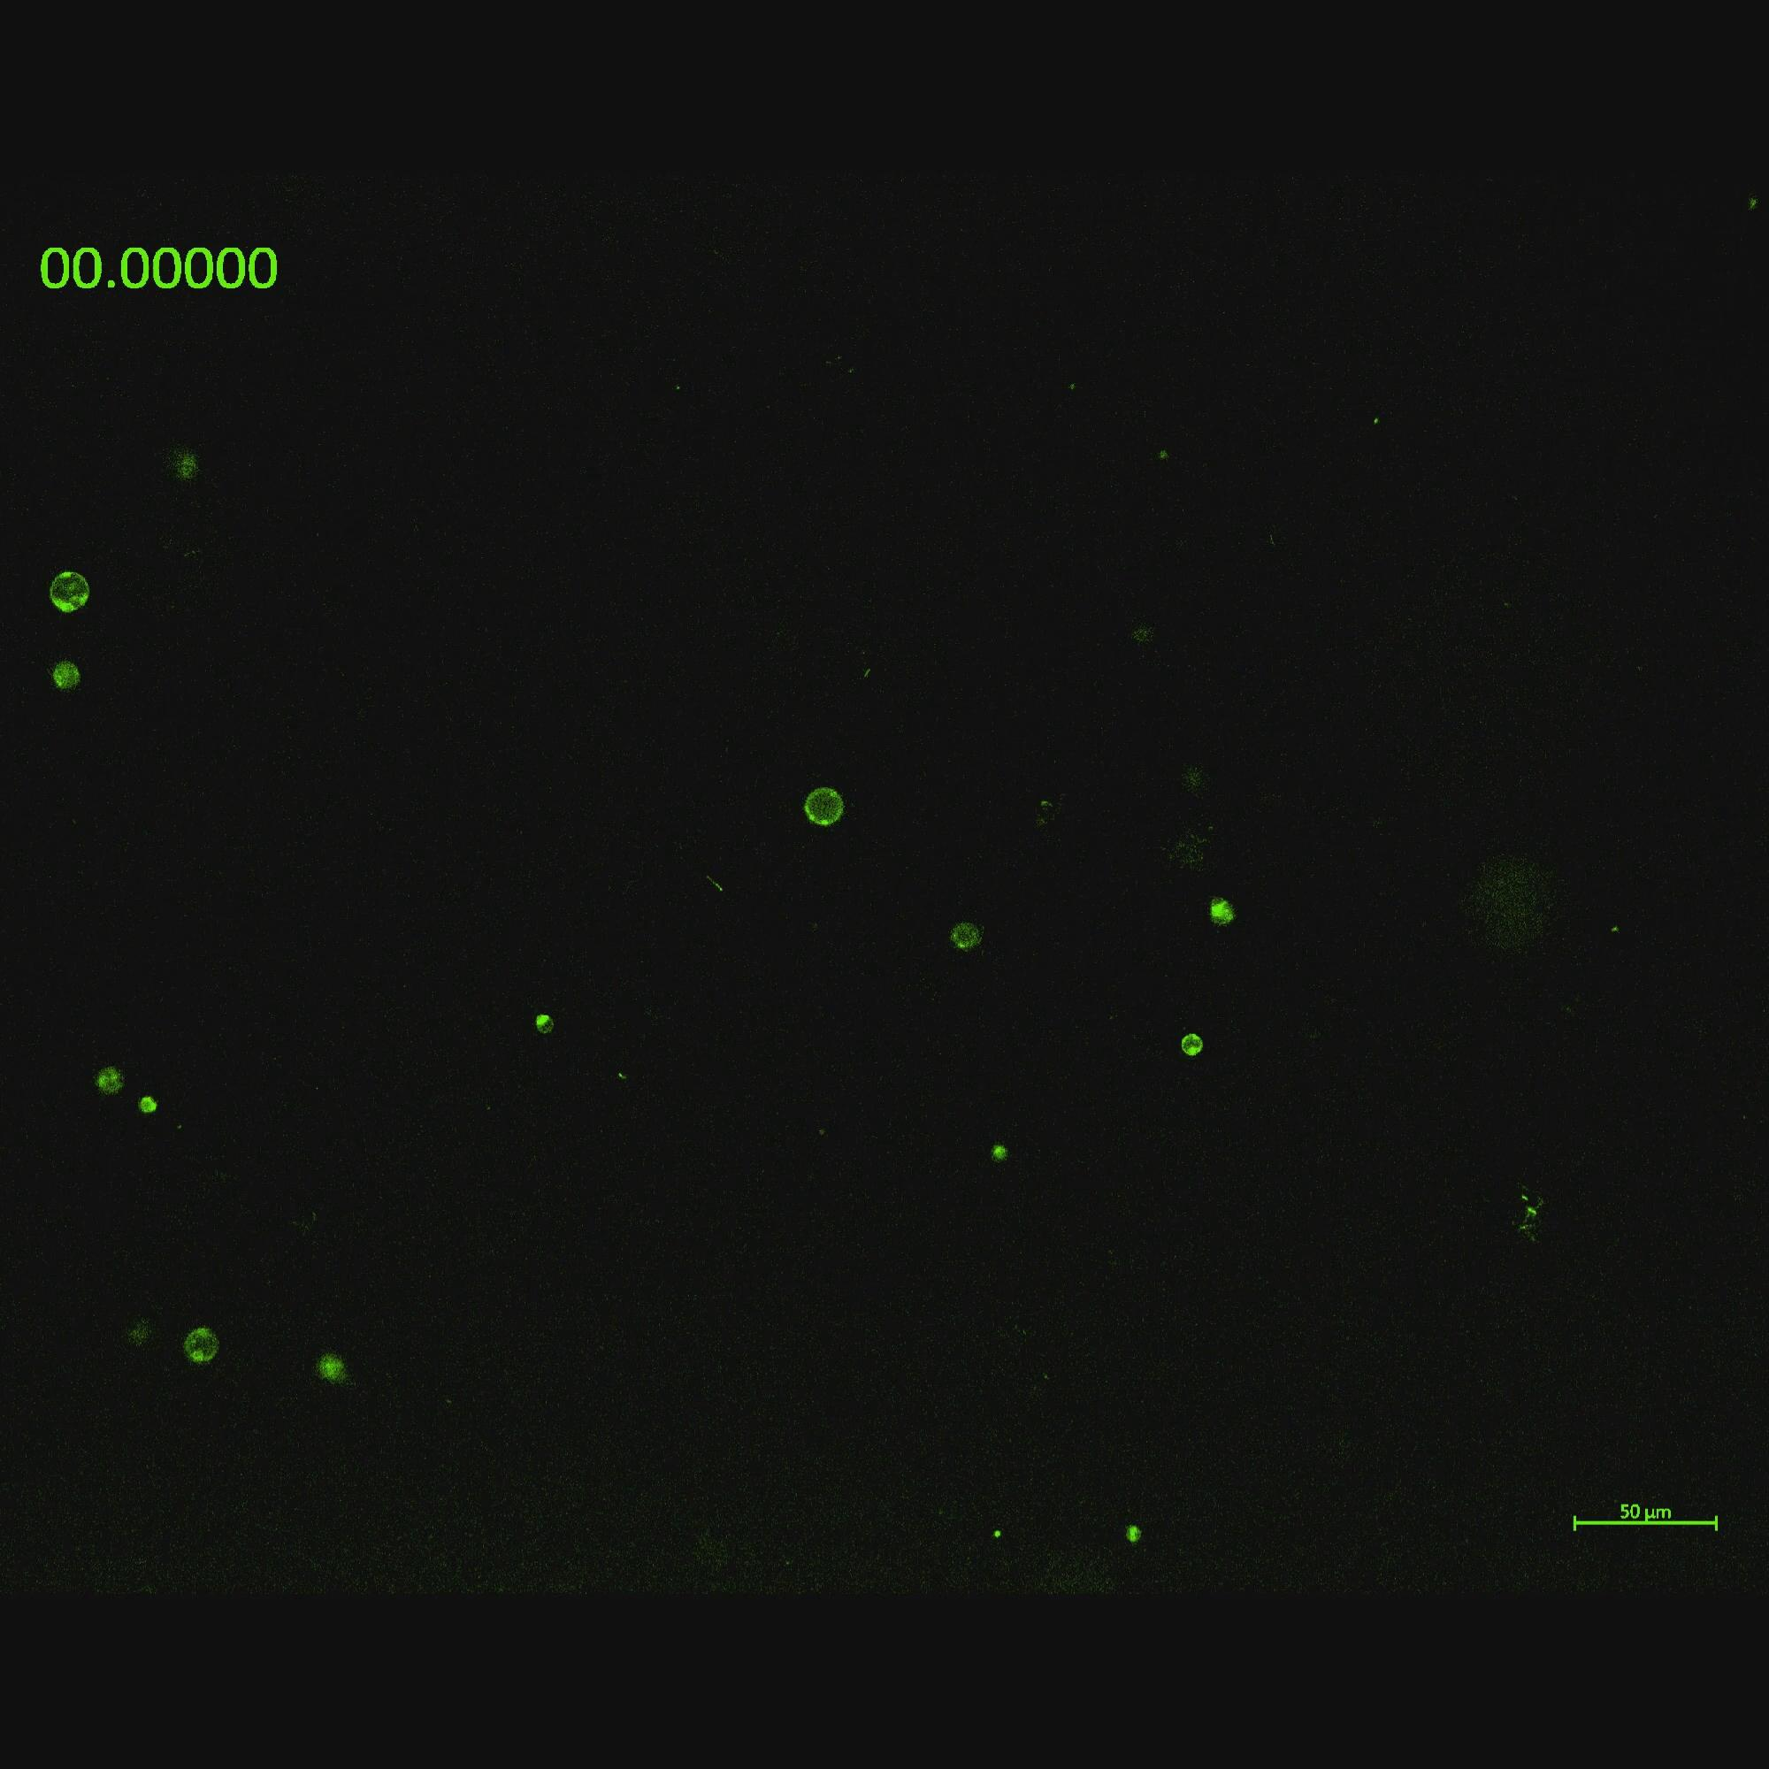
Membranes make Vesicles
Technological Features:
Can Encapsulate Large Volumes
Are Inexpensive
Can be Functionalized and Manipulated
Polymer/POPC hybrid vesicles immobilized on a BSA-treated slide.
Santiago, Griepenburg, et al., unpublished.

Slide 7
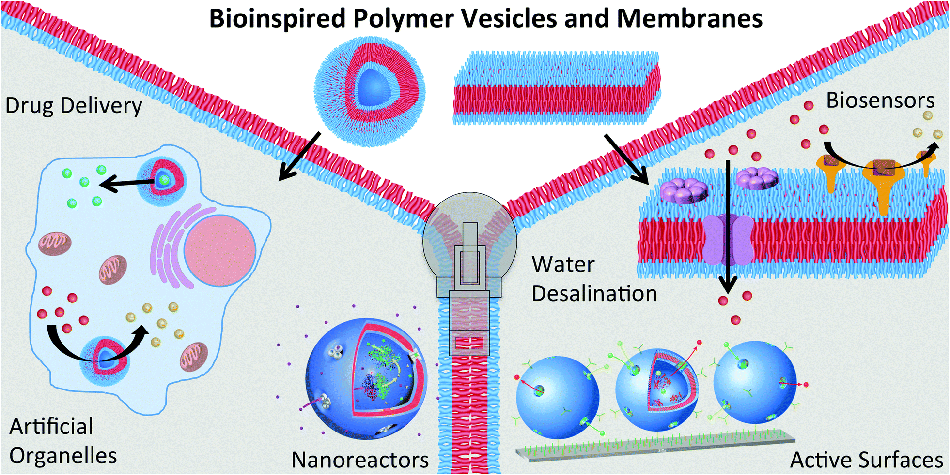
Applications of Synthetic Vesicles
Current:
Model Systems
Vehicles for Drug Delivery
Future:
Energy Storage
Reaction Vessels
Detection Systems
Illustration of applications for synthetic vesicles.
Palivan et al. 2016 https://doi.org/10.1039/C5CS00569H

Slide 8
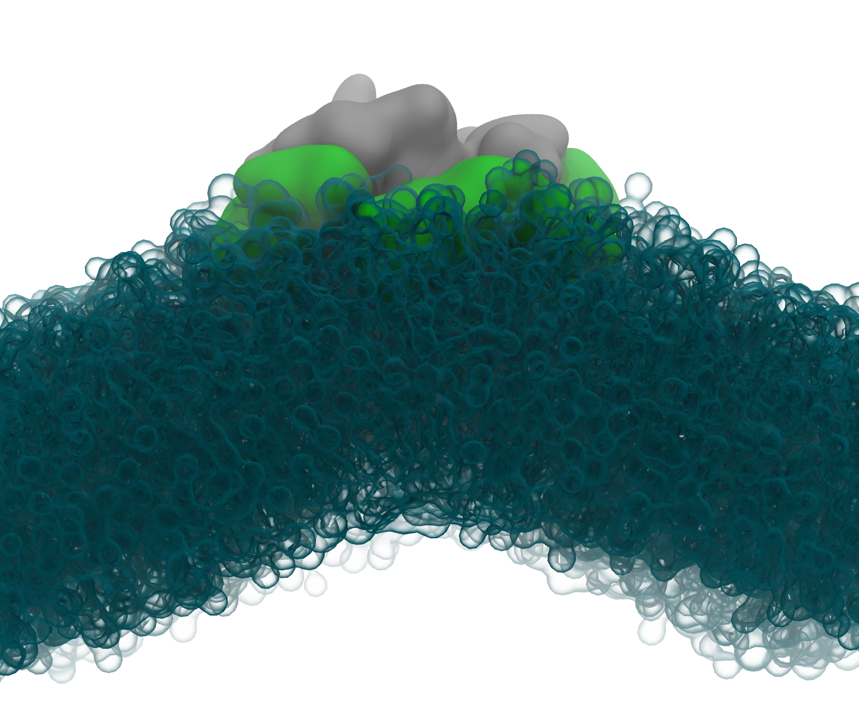
Why not functionalize with transmembrane proteins?
Natural membrane inclusions:
Polypeptide-based
Anchored by hydrophobic motifs
Evolved to interact with and functionalize membranes
Novel proteins are:
Not modular
Unpredictable (relatively)
Expensive
Example side view of a transmembrane protein deforming the membrane around it. Sandberg & Brannigan, unpublished.
Notes:
What can we learn from them?
What do we want to do that they do?

Slide 9
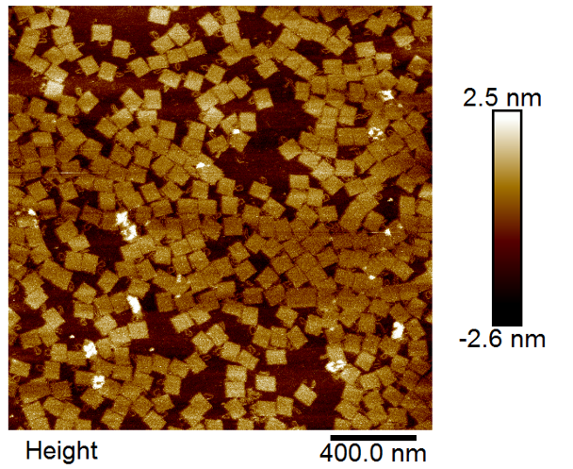
DNA Nanotechnology
Engineering Features:
Tractable Design using Base-Pairing
Good Structural and Dynamic Properties
Diverse post-synthetic conjugation chemistries
Top-down view of rectangular DNA Origami imaged by AFM. Each structure is 60x90x2.5nm.
Santiago & Fu, unpublished.

Slide 10
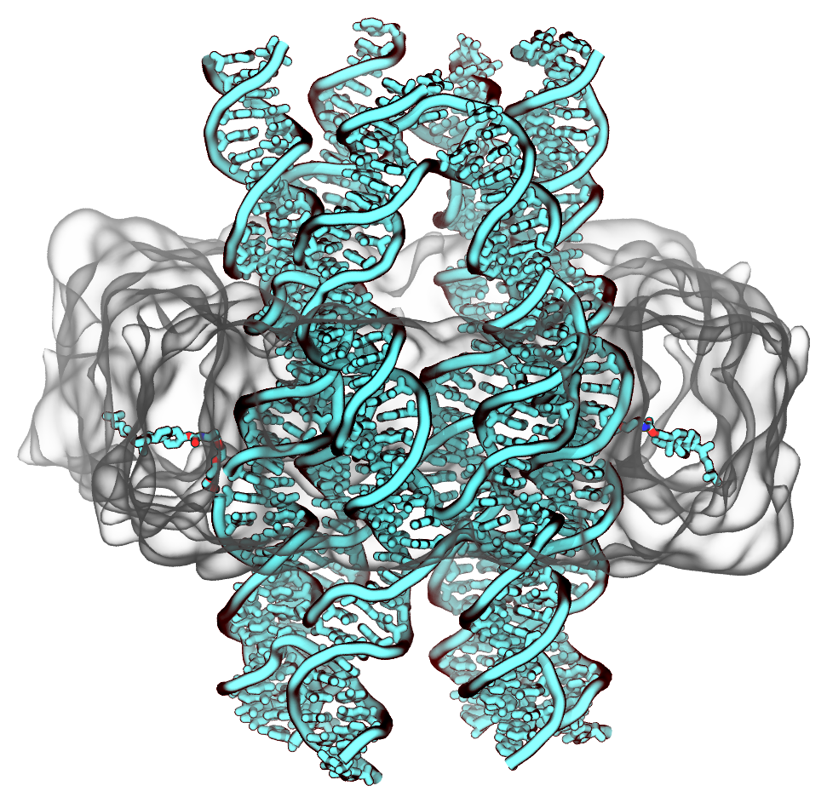
DNA and Membranes
DNA 6-helix bundle
Some challenges:
Require lipophilic prosthetic groups
Custom synthesis
Modified assembly
Extensive optimization
Prosthetic Groups
Membrane
Composite image showing a possible DNA transmembrane structure.

Slide 11
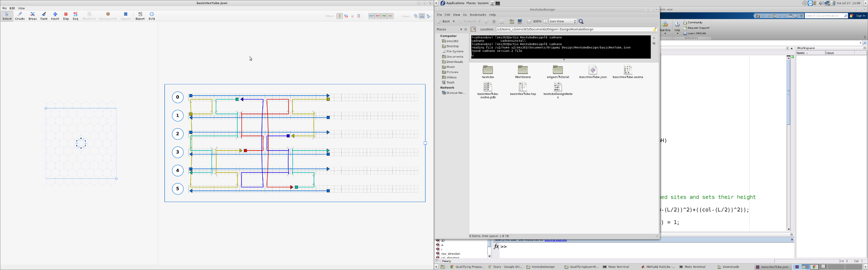
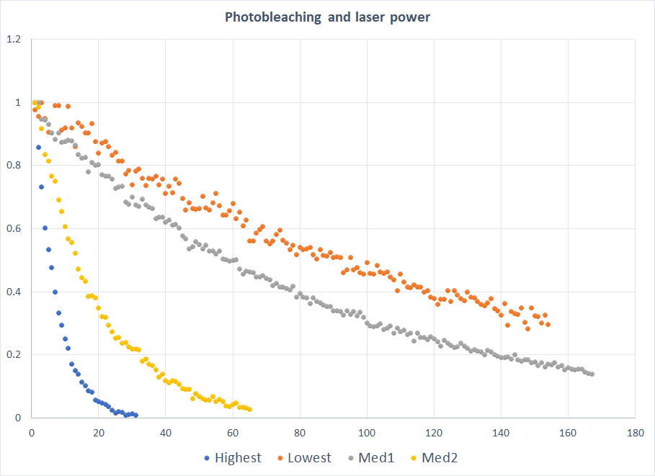
The Engineering Process
 | De-novo Proteins | DNA-only Systems | DNA-Membrane Systems
Design | Intractable | Tractable | Approximate/heuristic
Synthesis | Expensive | Commercial: 1-2 weeks, ~$100+ | Expensive/in-house
Assembly | ‘Spontaneous’ | Standardized | Variable
Applicability | One day | No | Immediate
Notes:
What does the current FuLab design process look like?
Where are the bottlenecks?
Why do those bottlenecks exist?
How can we overcome them?

Slide 12
Current Technologies

Slide 13
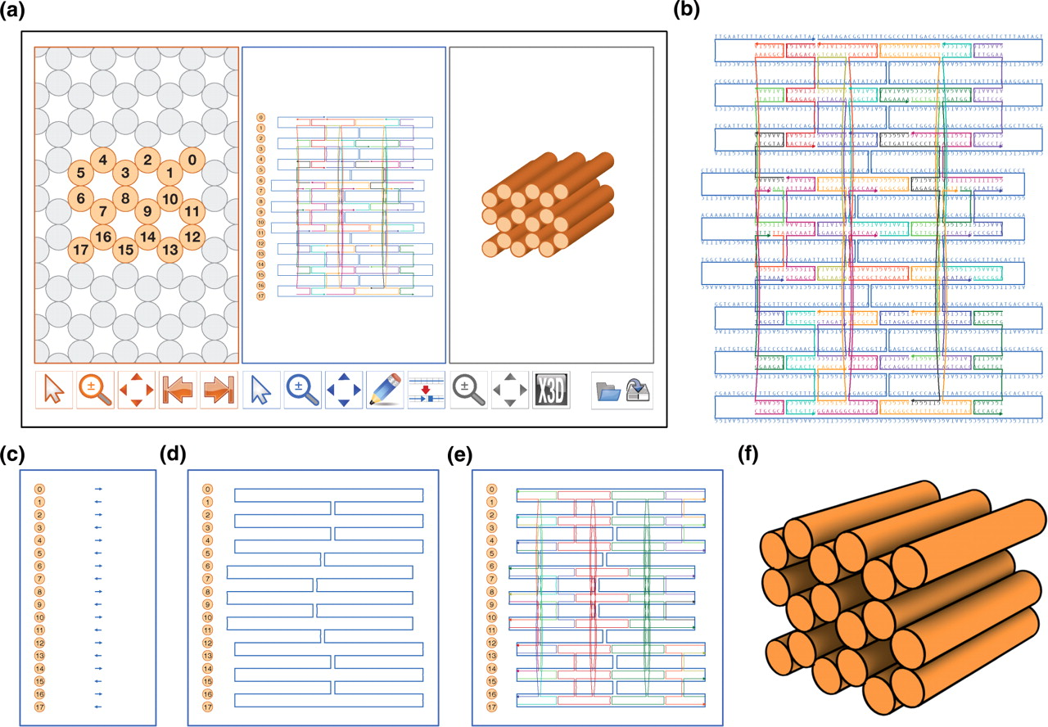
The state of the art - DNA Nanotechnology
Software like Cadnano (right)
Software handles:
Sequence assignment
Geometric constraints
Staple optimization (mostly)
Notes:
Figure 1. caDNAno Interface and design pipeline. ( a ) Screenshot of caDNAno interface. Left, Slice panel displays a cross-sectional view of the honeycomb lattice where helices can be added to the design. Middle, Path panel provides an interface to edit an unrolled 2D schematic of the scaffold and staple paths. Right, Render panel provides a real-time 3D model of the design. ( b ) Exported SVG schematic of example design from a, with scaffold (blue) and staple (multi-color) sequences. ( c ) Path panel snapshot during first step of the design process. Short stretches of scaffold are inserted into the Path panel as helices are added via the Slice panel. ( d ) The Path panel editing tools are used to stitch together a continuous scaffold path. ( e ) The auto-staple button is used to generate a default set of continuous staple paths, including crossovers. The breakpoint tool is subsequently used to split the staple paths into lengths between 18 and 49 bases. Finally, the scaffold sequence is applied to generate the list of staple sequences. ( f ) Exported X3D model from the Render panel.

Slide 14
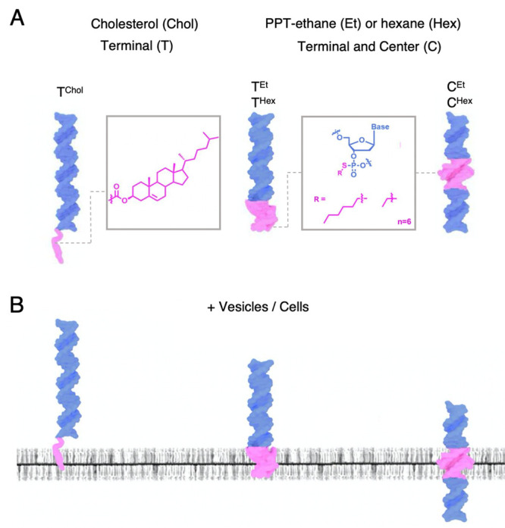
The state of the art - Hybrid DNA-Membrane Systems
Several model systems
Both experimental and computational
Common attributes:
Helix bundles
CholTEG
Common limitations:
Leaky
Disrupt the membrane
Is this really optimal?
Illustration of the interaction between DNA (blue), prosthetic groups (pink), and membranes (gray).
Jones et al. 2021 10.1021/jacs.0c13235

Slide 15
Two key questions:
What is the optimal prosthetic group?
What is the optimal inclusion shape for DNA origami?

Slide 16
Aim 1: What is the ‘best’ prosthetic group?
Has the most negative free energy of insertion.
Minimally disturbs the membrane.

Slide 17
Computational methods to date:
Classical Molecular Dynamics
Steered Molecular Dynamics

Slide 18
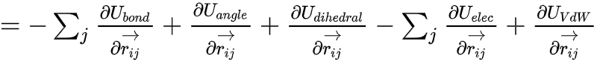
Classical MD
The Many-Body Problem:
Given 3 or more particles and their interaction forces, how will their positions evolve in time?
MD’s Answer:
Numerical integration of Newton’s Laws of Motion
For each atom i, sum over the force exerted by all (nearby) j
Update positions assuming a free path over small time step dt
Repeat

Slide 19
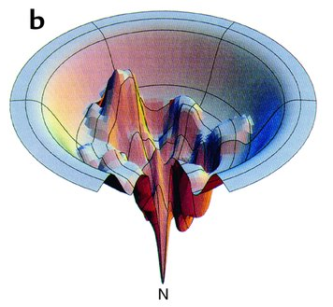
What about rare events or conformational changes?
Steered MD forces one or more particles to move in a certain direction
Pros:
Intuitive connection to AFM pulling
Faster than waiting for classical MD
Cons:
Only samples one physical path at a time AND
We have to guess the paths
A rugged free energy landscape
Dill & Chan, Nat. Struct Mol Biol 1997 https://doi.org/10.1038/nsb0197-10

Slide 20
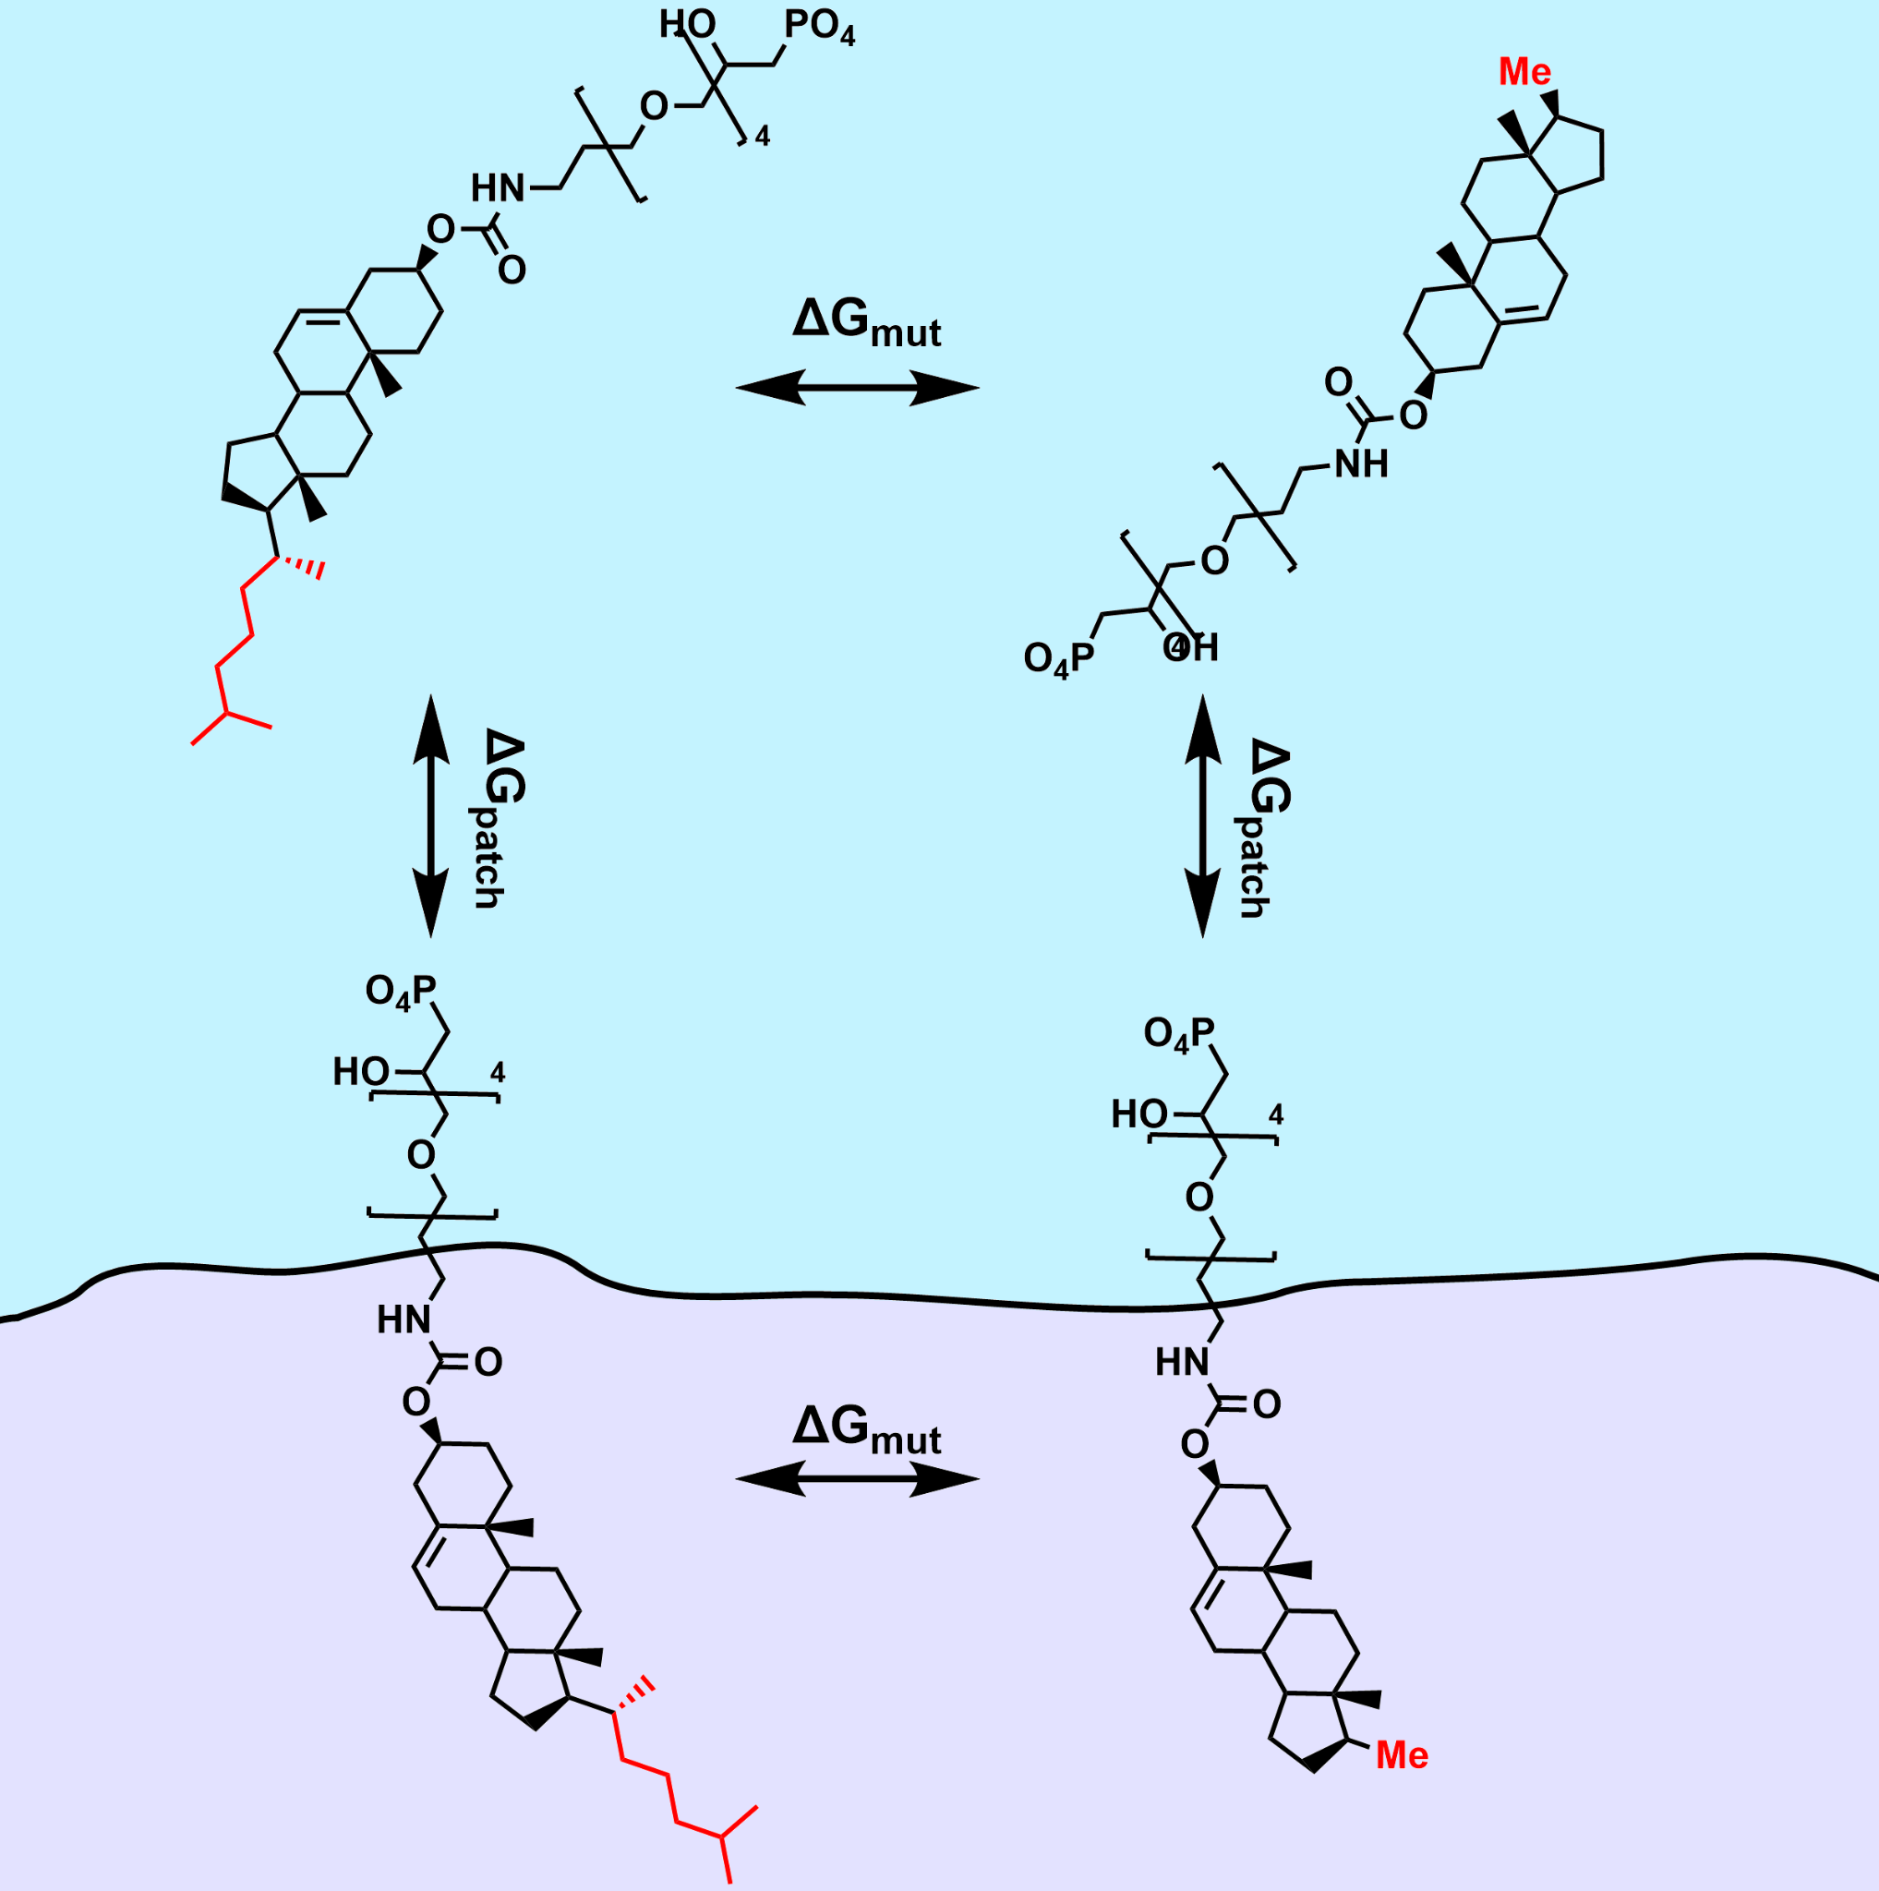
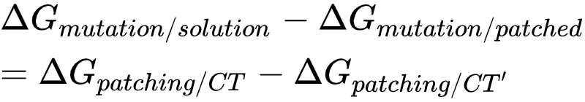
Simplify the Problem
CholTEG CholTEG’
Consider the path-independent condition
Relative free energy differences!
Solution
Membrane

Slide 21
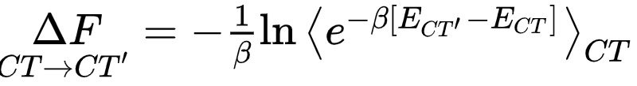
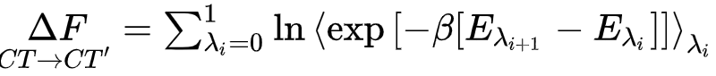
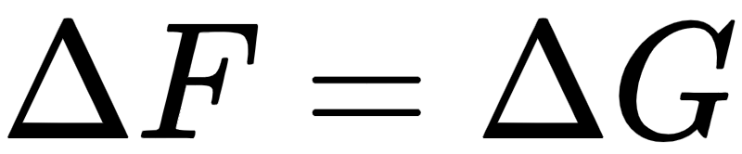
Free Energy Perturbations
CholTEG CholTEG’
Solution
Membrane
When enthalpy is roughly constant

Slide 22
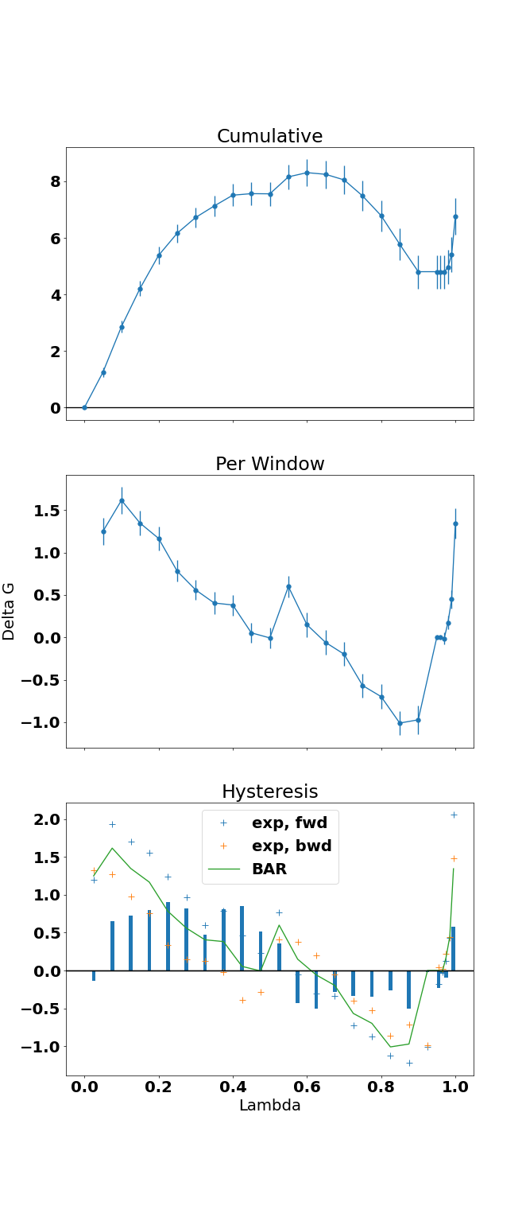
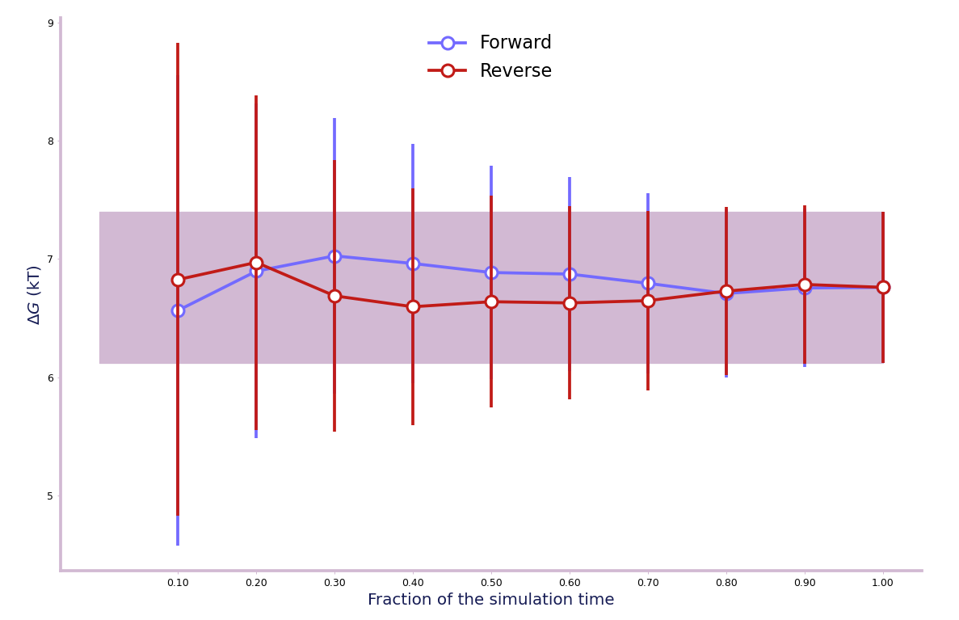
FEP Preliminary Data

Slide 23
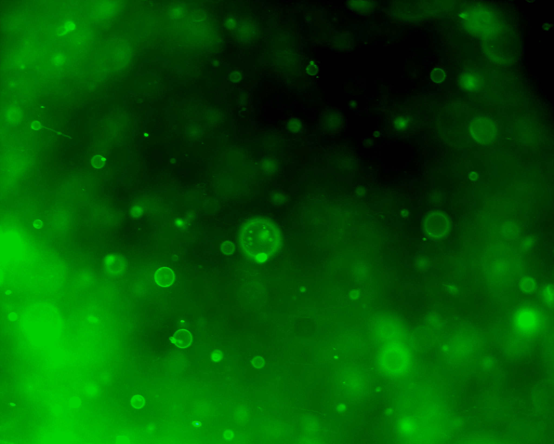
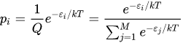
Approach: Experiment
Probability of inserting/patching is related to the relative free energy of that state:
Measured using:
AFM
Confocal Microscopy
Fluorescence Correlation Spectroscopy

Slide 24
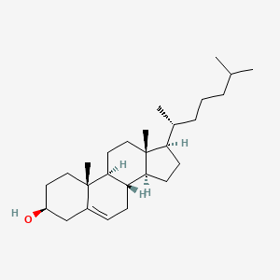
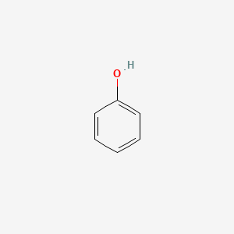
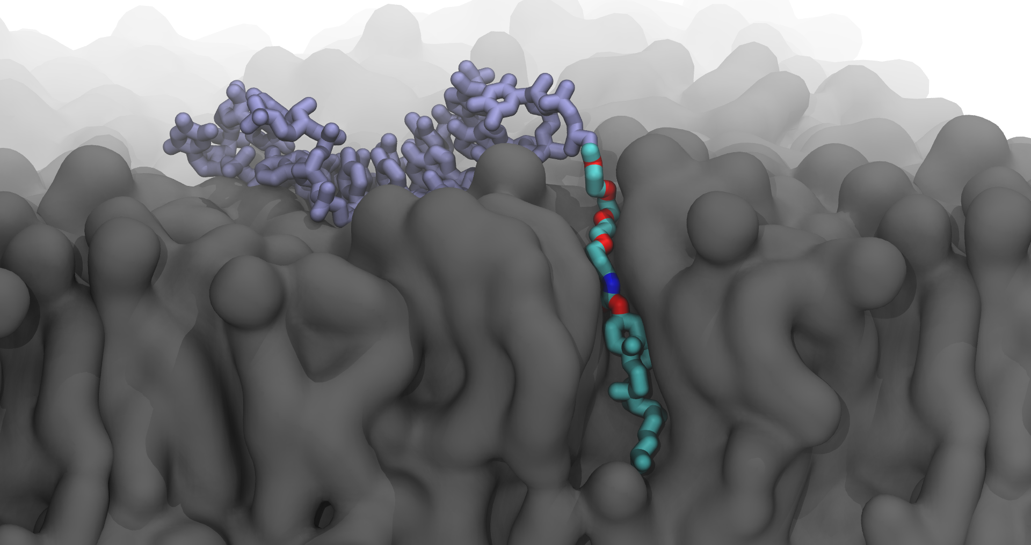
Aim 1: Prosthetic groups
Steps:
Build a library organized by Tanimoto distance
Parameterize each prosthetic group
Mutate between similar PGs using FEP
Validate Experimentally

Slide 25
Deliverables:
A library of at least 75 prosthetic group
A relative free energy of mutation for each (relative to cholTEG)
A systematic method to produce more such calculations

Slide 26
Aim 2: What is the optimal inclusion shape?

Slide 27
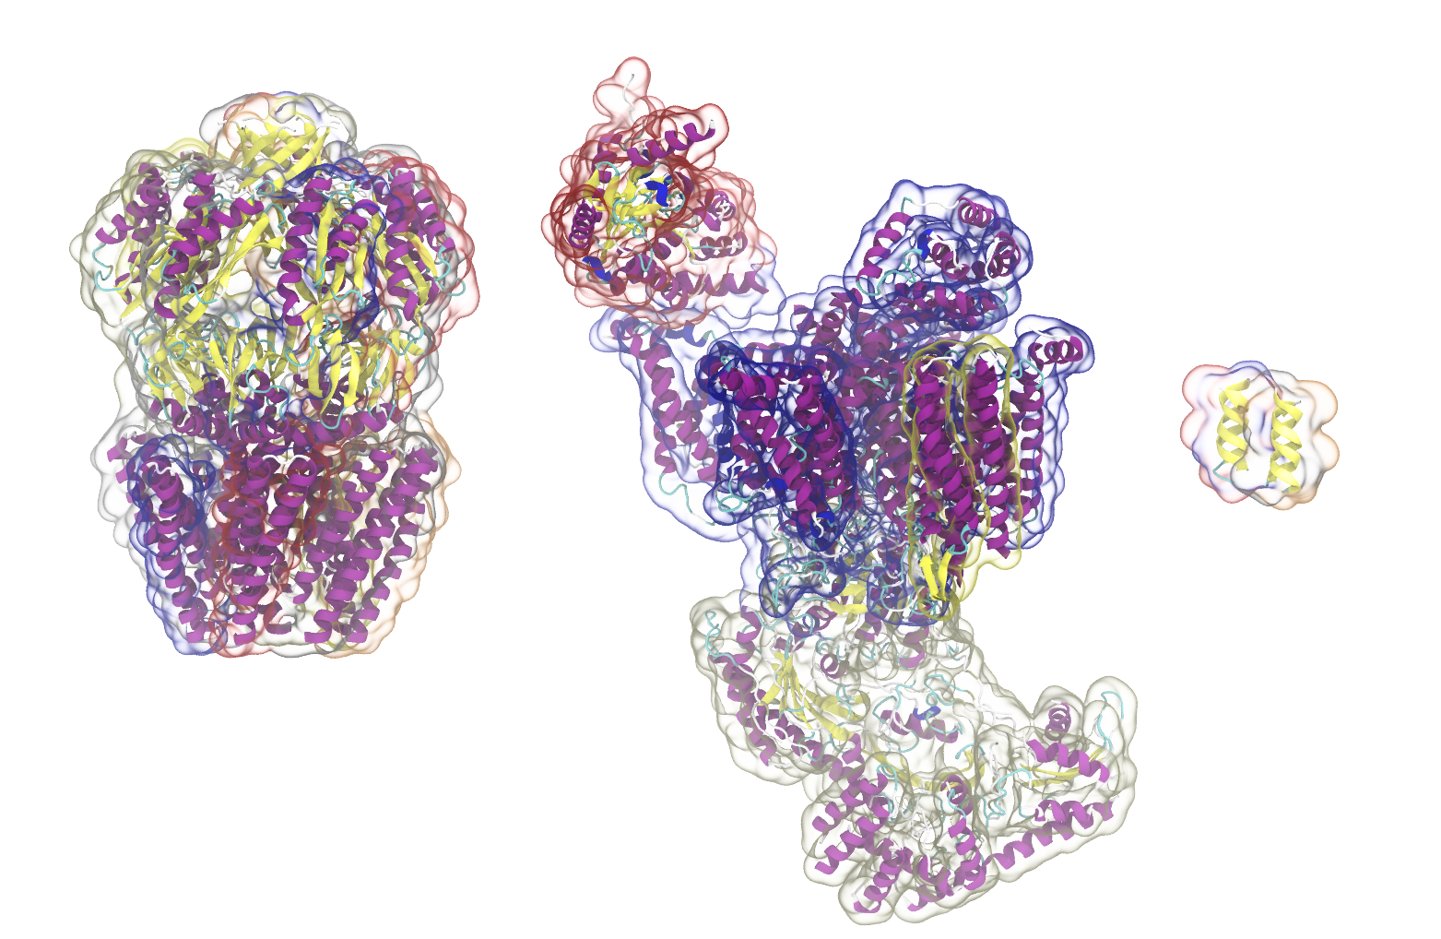
What makes a good inclusion?
One that has a good fit:
Doesn’t disrupt the membrane
Doesn’t permit passage of small molecules
Examples of transmembrane polypeptides. Rendered in VMD, Santiago.

Slide 28
Approach: Leverage existing work on Proteins
Model the DNA inclusion using:
Coarse-grained FEP for initial dG Estimates
Continuum Model for Membrane Deformations
AA FEP for refining and validating CG estimates for dG

Slide 29
How will you design the DNA inclusions?
Two Steps Based on Natural Inclusions:
Fill the bulk with standard design protocols
Refine the interface with prosthetic groups
Compare structures with each of the three models
Composite image showing a possible DNA transmembrane structure.

Slide 30
Deliverables:
Semi-quantitative comparisons of DNA membrane inclusions
An improved design methodology for transmembrane DNA nanostructures
A method to validate and optimize those nanostructures in-silico

Slide 31
Aim 3: How can we get additional functionality?

Slide 32
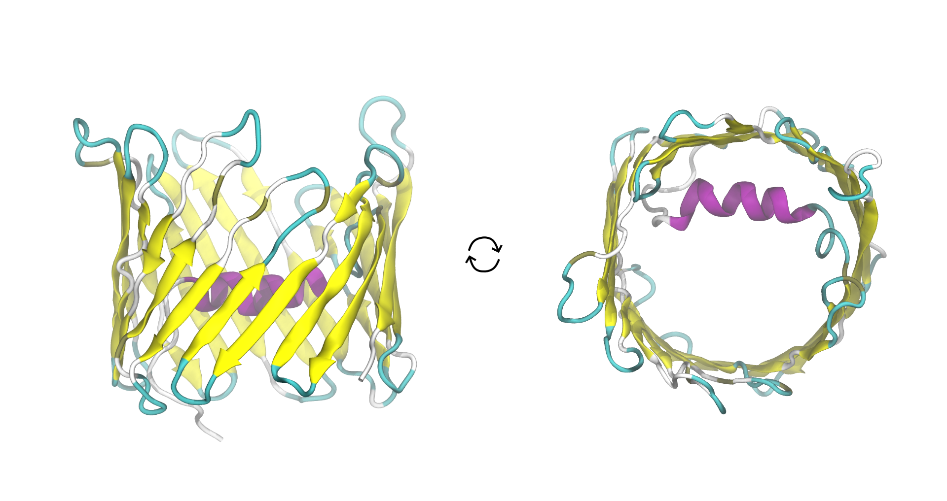
Design of a Gated Nanopore
The system will be modeled on the human mitochondrial voltage dependent anion channel (right)
Closed and open state will be distinguished by permeability
The helix will be replaced with a gold nanoparticle
Side view
Top-Down
Images of the voltage dependent anion channel. Rendered with VMD, Santiago. (pdb: 2JK4)

Slide 33
How will you design the structure?
The structure will be based on the results of Aims 1 and 2.
The pore will be designed using standard methods
Gating possibilities:
A) plasmonic heating-induced local dehybridization
B) voltage sensitivity
Enhanced sampling -> permeability
Electric field -> Voltage effects
Independent variables: Nanoparticle size, tether length, pore diameter

Slide 34
Deliverables
At least one reversibly gated DNA nanopore design
A method to predict the permeability of a DNA transmembrane nanostructure
Refined methodologies for gating simulations

Slide 35
Summary
Goal: Facilitate the design process for synthetic vesicles functionalized with transmembrane DNA nanostructures
Steps:
Identify the most stable prosthetic groups in each membrane
Compare using AA FEP thermodynamic cycles
Validate experimentally.
Identify optimal geometries for each membrane
CG and AA simulations with metadynamics and FEP
Continuum models
Design and describe a synthetic ion channel
AA metadynamics and/or adaptive biasing force simulations

Slide 36
Timeline
2021:
Summer-Fall: Prosth. Gp. Library 1.1, FEP 1.2, Begin Experiments 1.3
2022:
Winter-Spring: Finish 1.3, Begin 2.1 - CG/Continuum Simulations
Summer-Fall: 2.1, 2.2 - CG FEP, 2.3 - AA Simulations and FEP
2023:
Winter-Spring: 2.3
Summer-Fall: 3.1 - permeability of basic barrel, 3.2 - permeability with stopper
2024:
Winter-Spring: 3.3 - Identify biasing conditions

